Slide 1


Prakrati Gupta
19/09/2021

Slide 2

Outline
Executive Summary
Introduction
Methodology
Results
Conclusion
Appendix

Slide 3
Executive Summary
Summary of Methodologies
Data collection
Data wrangling
EDA with data visualization
EDA with SQL
Building an interactive map with Folium
Building a Dashboard with Plotly Dash
Predictive analysis (Classification)
Summary of all results
The trained machine learning model and use the data from SpaceX to determine if space will reuse the first stage and success rate of each launch in SpaceY.
Exploratory data analysis results
Interactive analytics demo in screenshots
Predictive analysis results

Slide 4
Introduction
Project background and context
The commercial space age is here, companies are making space travel affordable for everyone. the most successful is SpaceX. SpaceX advertises Falcon 9 rocket launches on its website with a cost of 62 million dollars; other providers cost upwards of 165 million dollars each, much of the savings is because SpaceX can reuse the first
Project Scope
Space Y would like to compete with Space X. To determine the price of each launch, this is done by gathering information about Space X and creating dashboards.
Problems you want to find answers
What are the variables influencing the rocket landing?
What is the relationship of the variables with successful landing?
What are the best conditions to ensure highest successful landing?

Slide 5


Slide 6
Methodology
Executive Summary
Data collection methodology:
Perform data wrangling
Perform exploratory data analysis (EDA) using visualization and SQL
Perform interactive visual analytics using Folium and Plotly Dash
Perform predictive analysis using classification models

Slide 7
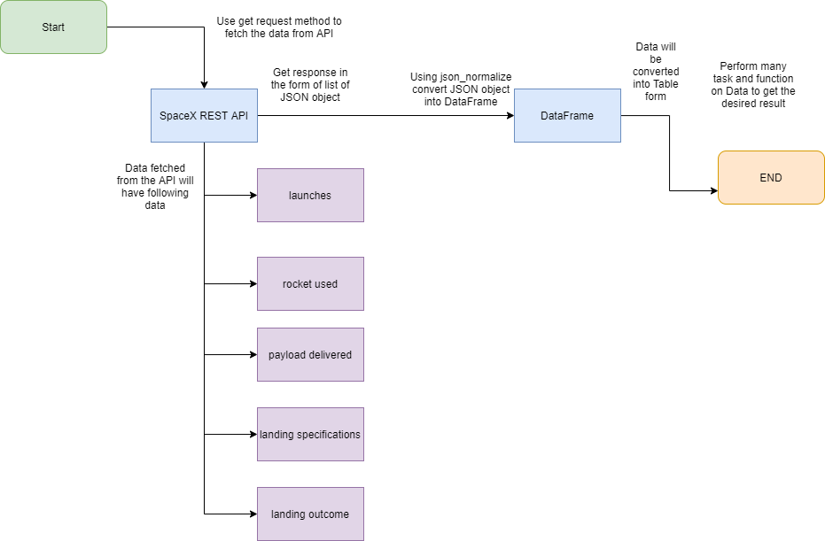
Data Collection – SpaceX API
We will be working with SpaceX launch data that is gathered from an API, specifically the SpaceX REST API. This API will give us data about launches, including information about the rocket used, payload delivered, launch specifications, landing specifications, and landing outcome.
The SpaceX REST API endpoints, or URL, starts with api.spacexdata.com/v4/. We have the different end points, for example: /capsules and /cores We will be working with the endpoint api.spacexdata.com/v4/launches/past.
GitHub URL
Place your flowchart of SpaceX API calls here

Slide 8
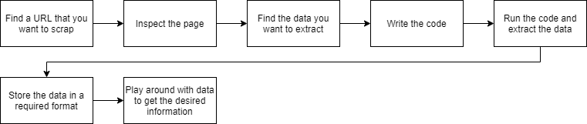
Data Collection - Scraping
Imagine you have to pull a large amount of data from websites, and you want to do it as quickly as possible. How would you do it without manually going to each website and getting the data? Well, “Web Scraping” is the answer. Web Scraping just makes this job easier and faster.
GitHub URL

Slide 9
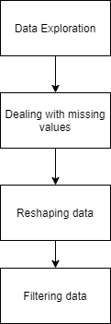
Data Wrangling
Data Wrangling is the process of gathering, collecting, and transforming Raw data into another format for better understanding, decision-making, accessing, and analysis in less time.
Data Wrangling is a crucial topic for Data Science and Data Analysis. Pandas Framework of Python is used for Data Wrangling. Pandas is an open-source library specifically developed for Data Analysis and Data Science. The process like data sorting or filtration, Data grouping, etc.
GitHub URL

Slide 10
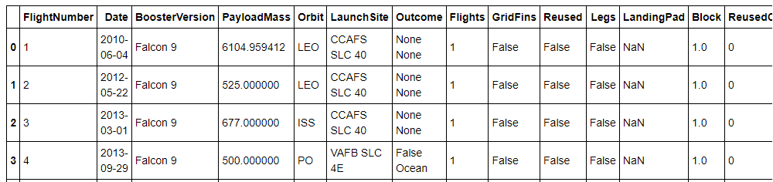
EDA with Data Visualization
EDA – Exploratory Data Analysis
Exploratory Data Analysis refers to the critical process of performing initial investigations on data to discover patterns, to spot anomalies, to test hypothesis and to check assumptions with the help of summary statistics and graphical representations.
GitHub URL

Slide 11
EDA with SQL
Exploratory Data Analysis refers to the critical process of performing initial investigations on data to discover patterns, to spot anomalies, to test hypothesis and to check assumptions with the help of summary statistics and graphical representations.
GitHub URL

Slide 12
Build an Interactive Map with Folium
Folium is a Python library used for visualizing geospatial data. It is easy to use and yet a powerful library. Folium is a Python wrapper for Leaflet.js which is a leading open-source JavaScript library for plotting interactive maps
Markers are the items used for marking a location on a map. For example, when you use Google Maps for navigation, your location is marked by a marker and your destination is marked by another marker. Markers are among the most important and helpful things on a map.
Folium gives a folium. Marker() class for plotting markers on a map. Just pass the latitude and longitude of the location, mention the popup and tooltip and add it to the map.
GitHub URL

Slide 13
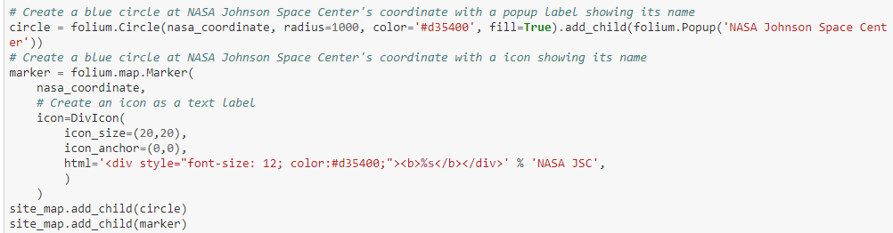
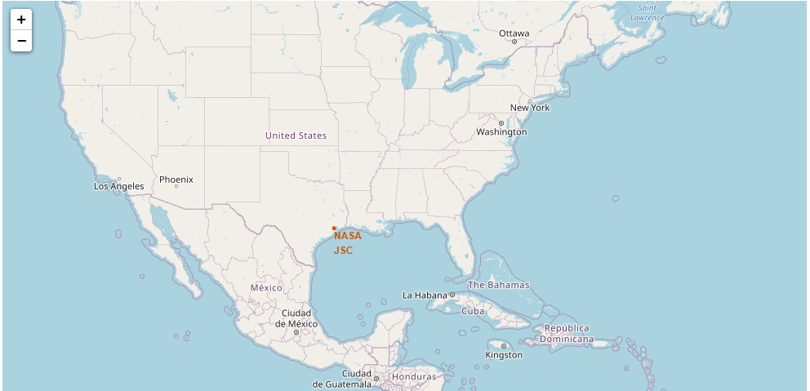
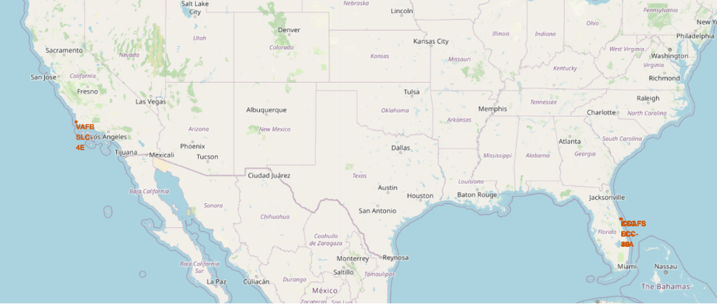
Build an Interactive Map with Folium

Slide 14
Build a Dashboard with Plotly Dash
Graphs
Pie Chart showing the total launches by a certain site/all sites.
Display relative proportions of multiple classes of data.
Size of the circle can be made proportional to the total quantity it represents.
Scatter Graph showing the relationship with Outcome and Payload Mass (Kg) for the different Booster Versions
It shows the relationship between two variables.
It is the best method to show you a non-linear pattern.
The range of data flow, i.e. maximum and minimum value, can be determined.
Observation and reading are straightforward.

Slide 15
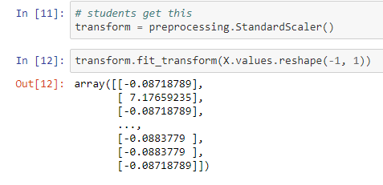
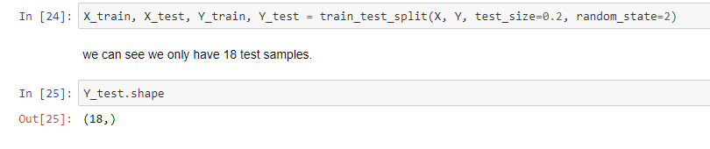
Predictive Analysis (Classification)
Predictive analytics is an applied field that uses a variety of quantitative methods that make use of data in order to make predictions.
The predictive analysis makes predictions on what might happen in the future using historical data. The data is gathered in base table which is consist of three important components: population, the candidate predictors and target.
GitHub URL

Slide 16
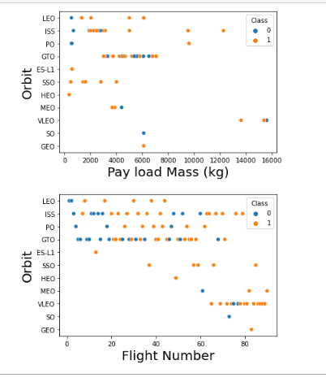
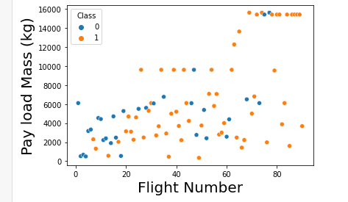
Results
Exploratory data analysis results
Interactive analytics demo in screenshots
Predictive analysis results

Slide 17


Slide 18
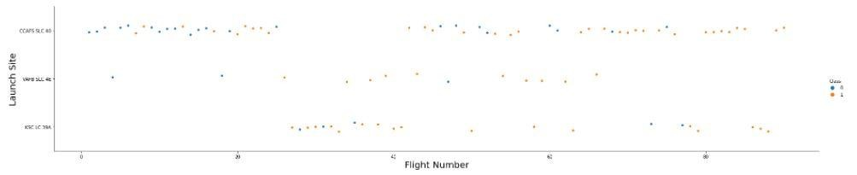
Flight Number vs. Launch Site
A scatter plot of Flight Number vs. Launch Site

Slide 19
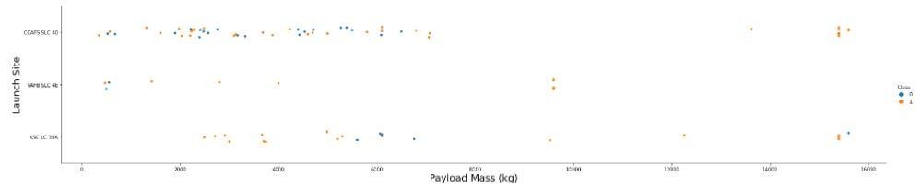
Payload vs. Launch Site
Show a scatter plot of Payload vs. Launch Site

Slide 20
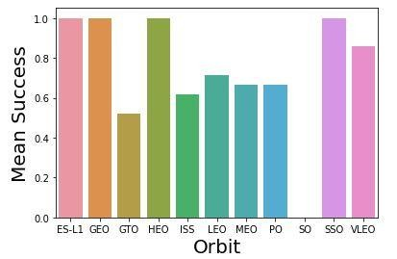
Success Rate vs. Orbit Type
Success Rate vs. Orbit Type

Slide 21
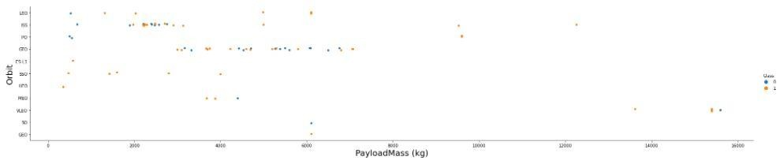
Payload vs. Orbit Type
Show a scatter point of payload vs. orbit type

Slide 22
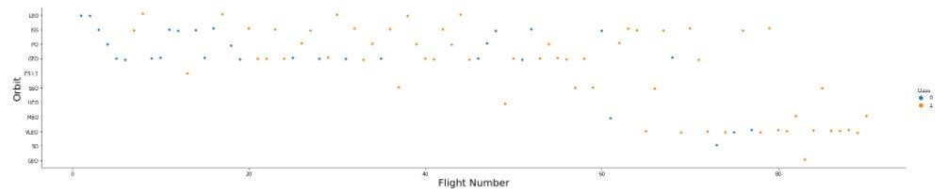
Flight Number vs. Orbit Type
Show a scatter point of Flight number vs. Orbit type

Slide 23
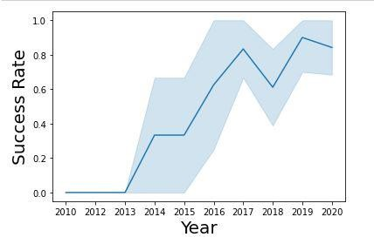
Launch Success Yearly Trend

Slide 24
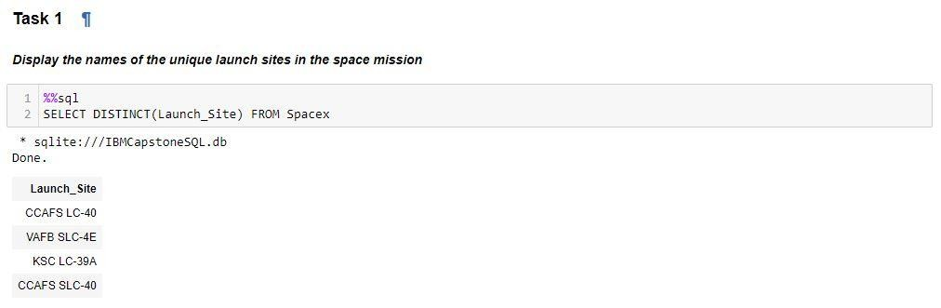
All Launch Site Names
Find the names of the unique launch sites
Present your query result with a short explanation here

Slide 25
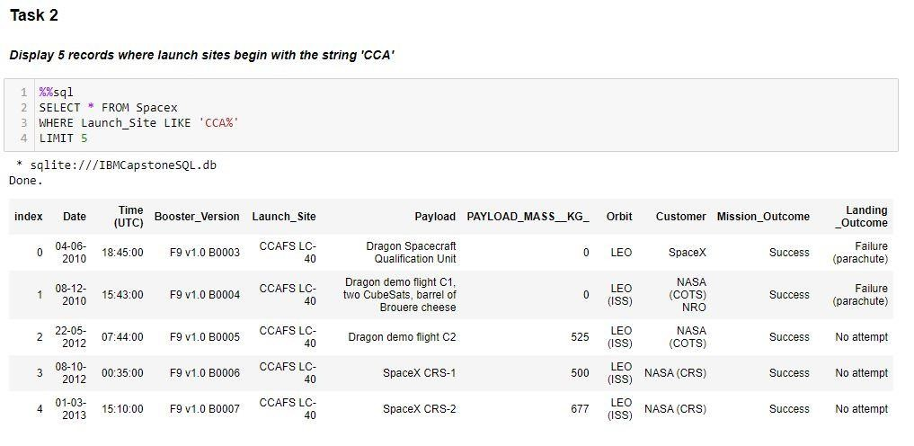
Launch Site Names Begin with 'CCA'
Find 5 records where launch sites begin with `CCA`
Using LIMIT in the query means that it will only show 5 records from table SpaceX and LIKE keyword has a wild card with the words ‘CAA%’ the percentage in the end suggests that the Launch Site name must start with CAA.

Slide 26
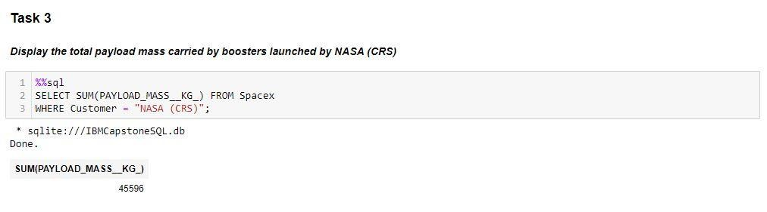
Total Payload Mass
Using the function SUM summates the total in the column PAYLOAD_MASS_KG. WHERE clause filters the dataset to only perform calculations when Customer is NASA (CRS).

Slide 27
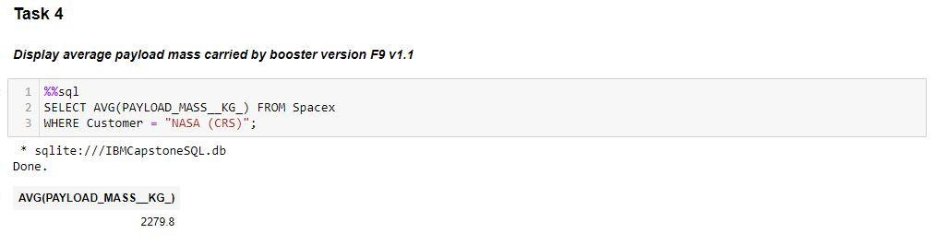
Average Payload Mass by F9 v1.1
Using the function AVG averages the values in the column PAYLOAD_MASS_KG_. WHERE clause filters the dataset to only perform calculations when Customer is NASA (CRS).

Slide 28
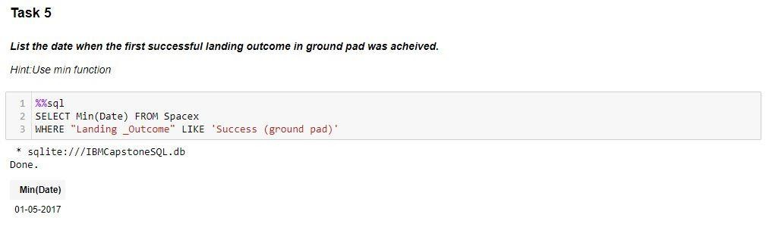
First Successful Ground Landing Date
MIN gets the minimum value. Where the WHERE clause filters the dataset to only perform calculations when Landing_Outcome is Success (ground pad).

Slide 29
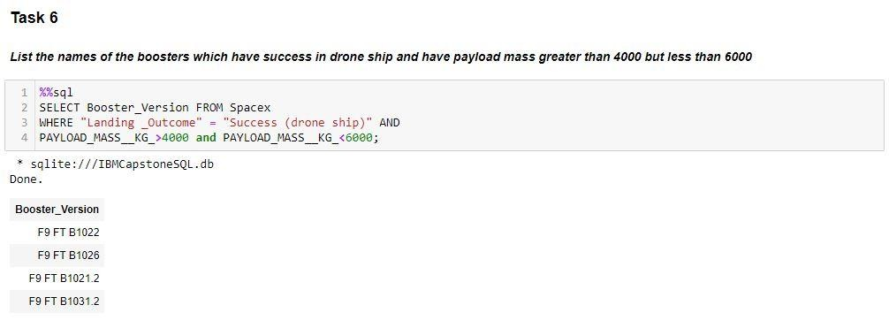
Successful Drone Ship Landing with Payload between 4000 and 6000
Select only Booster_Version, WHERE the dataset Landing_Outcome is Success (drone ship) and PAYLOAD_MASS_KG_ is between 4000 - 6000

Slide 30
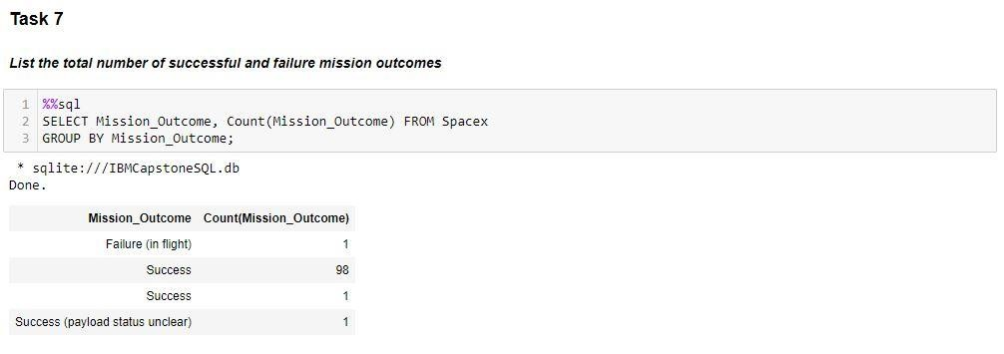
Total Number of Successful and Failure Mission Outcomes
Select Mission_Outcome and Count the number of Mission_Outcome. GROUP BY ensures summing of Count values.

Slide 31
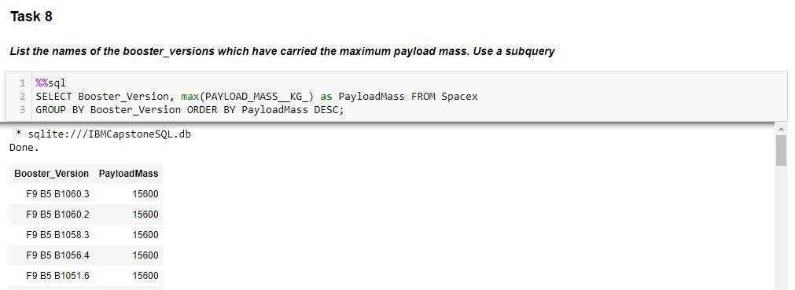
Boosters Carried Maximum Payload
Select Booster_Version and Max(PAYLOAD_MASS_KG_) only.GROUP BY ensures distinct Booster_Version and ORDER BY (DESC) sets the order of the results.

Slide 32
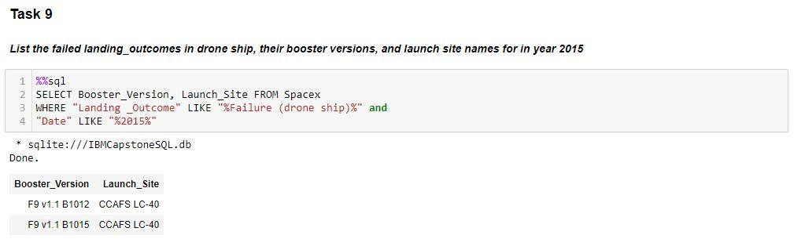
2015 Launch Records
Select Booster_Version and Launch_Site, WHERE the dataset Landing_Outcome is Failed (drone ship) and Date has the word 2015 to ensure the year.

Slide 33
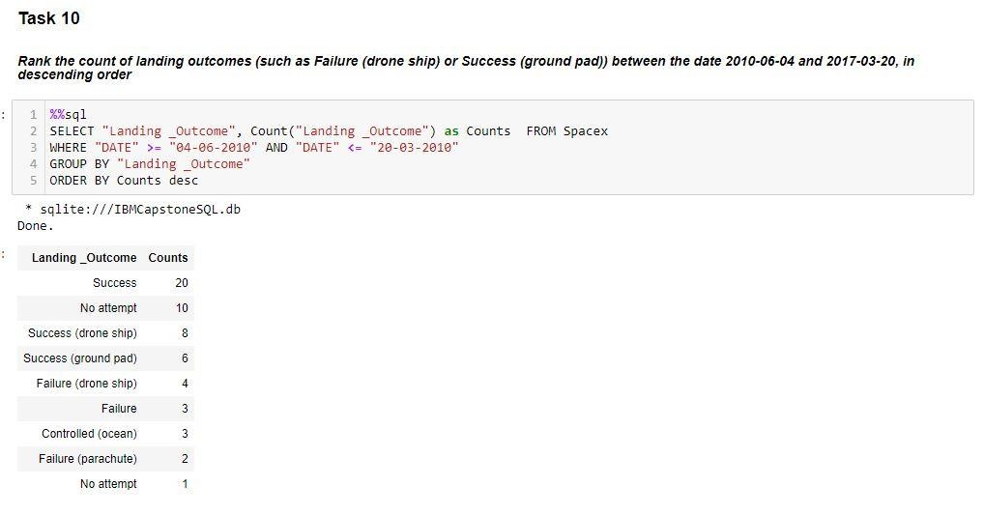
Rank Landing Outcomes Between 2010-06-04 and 2017-03-20

Slide 34


Slide 35
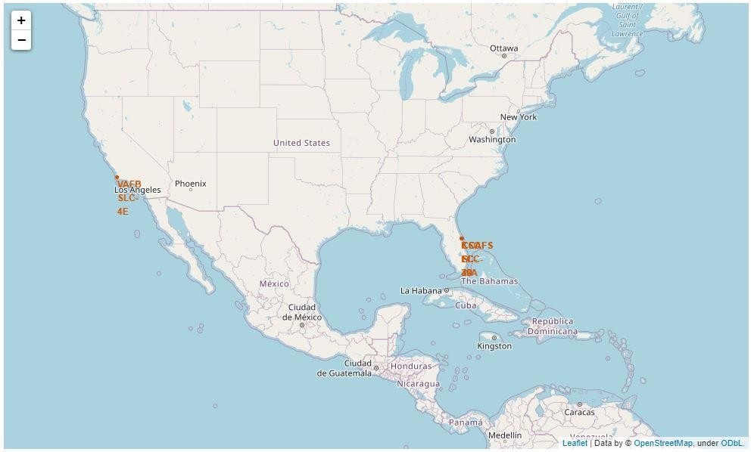
All Launch Site for Falcon 9

Slide 36
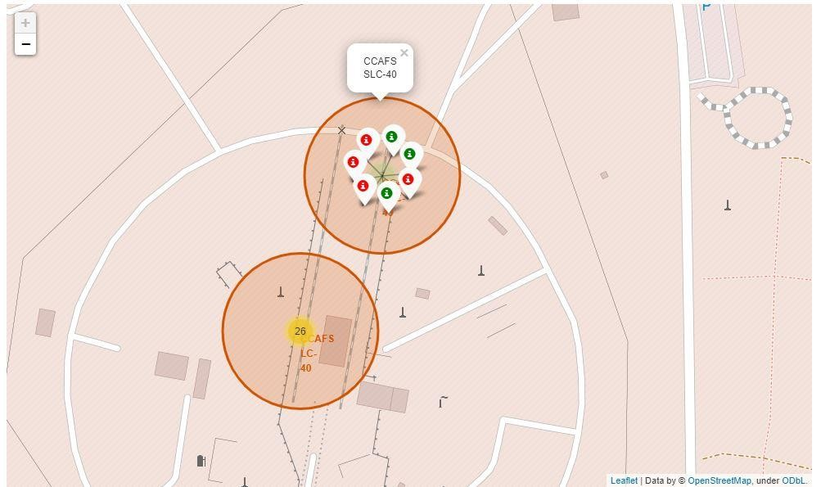
Color Labelled Markers for Sites

Slide 37
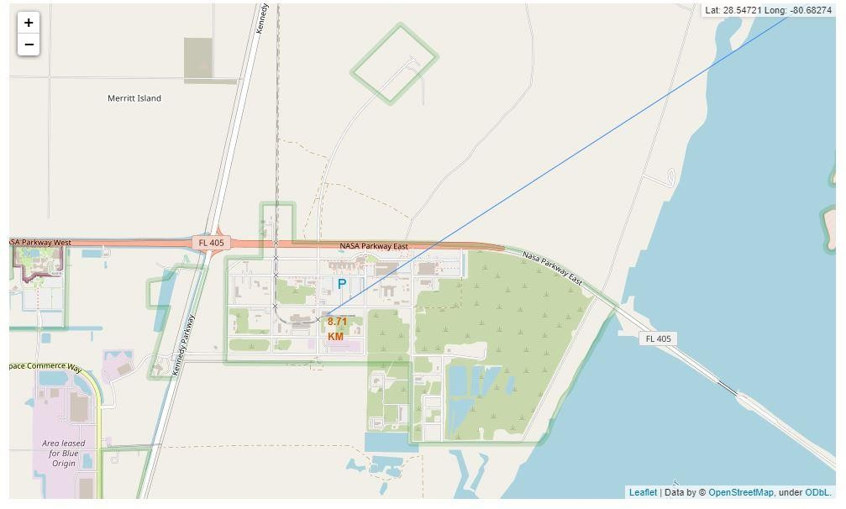
Launch Site distance to Railway Station

Slide 38


Slide 39
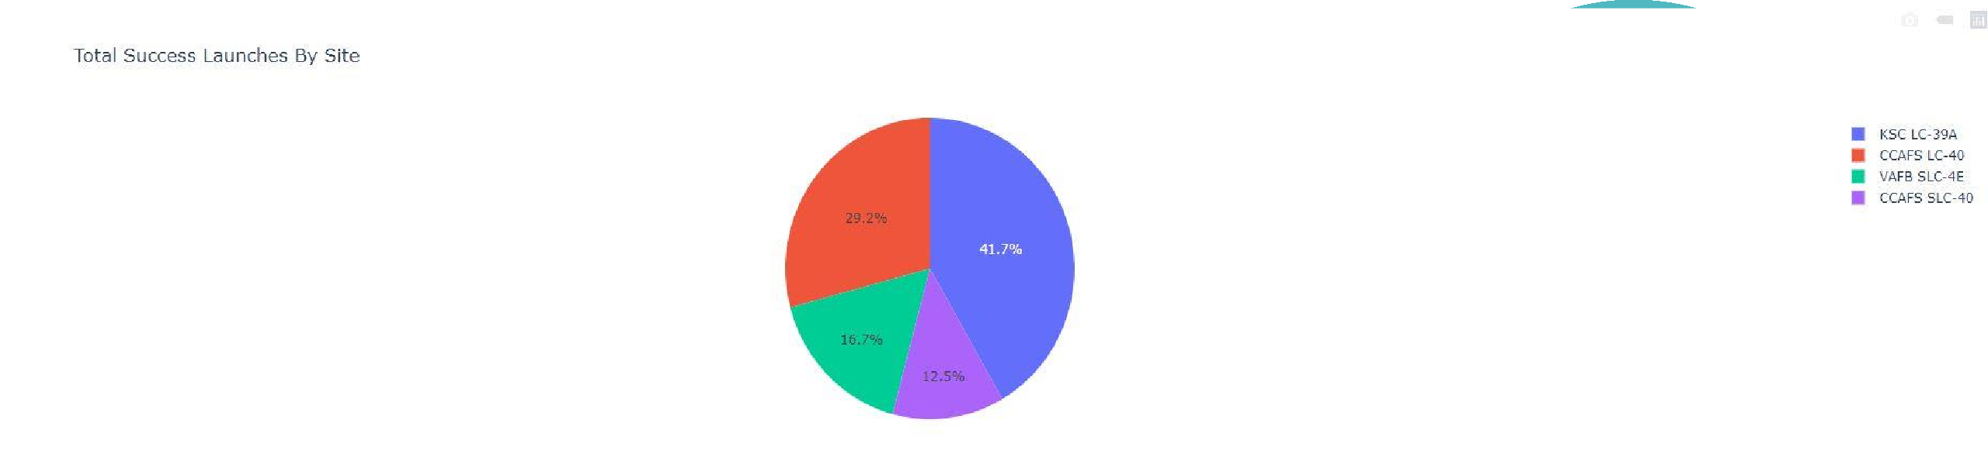
Success percentage by Launch Site
We can see that KSC LC-39A had the most successful launches from all the sites. A particular Launch Site can be selected on the right side to show results on for that particular Site.

Slide 40
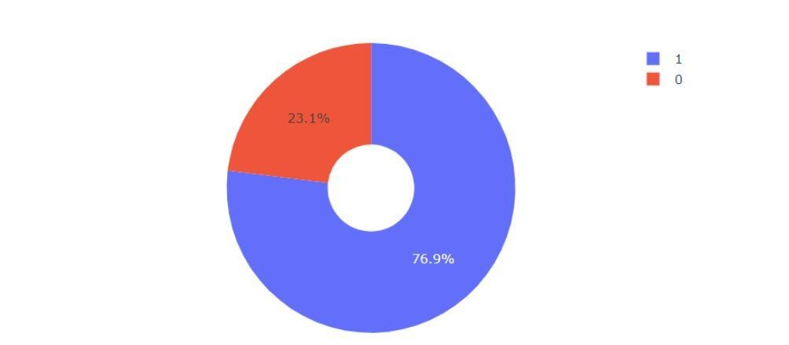
Success Ration for KSC LC-39A
KSC LC-39A achieved a success rate of 76.9% while the failure rate was 23.1%

Slide 41
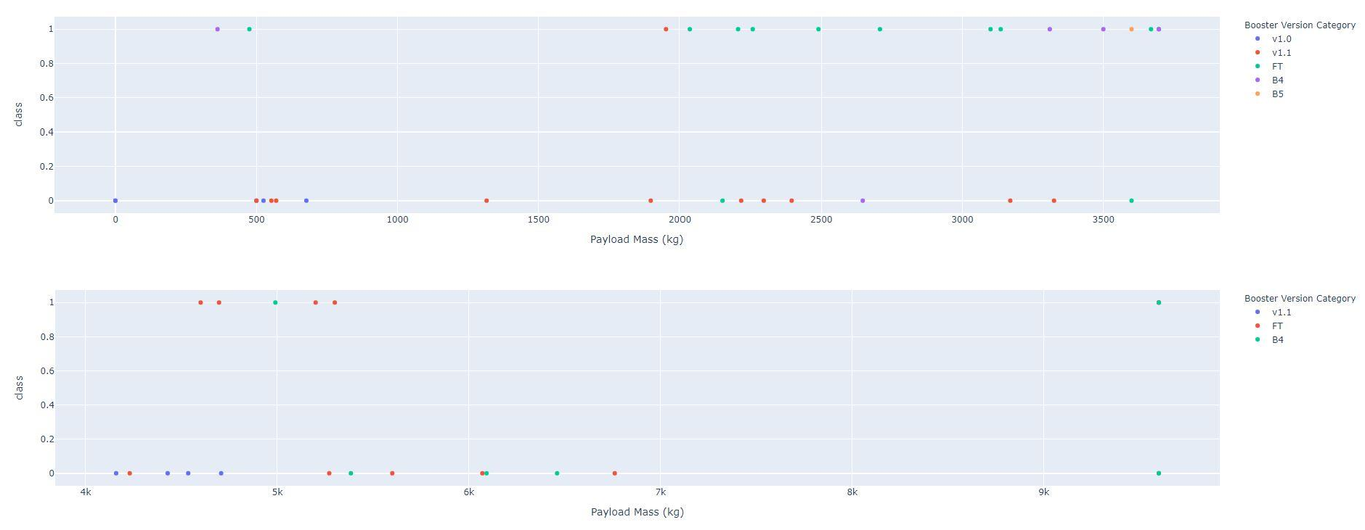
Payload against Launch Outcome
It can be observed that the success rate for low weighted payloads is higher than the heavy weighted payloads

Slide 42


Slide 43
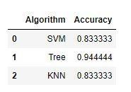
Classification Accuracy
After selecting the best hyperparameters for the decision tree classifier using the validation data, achieved 94.44% accuracy on the test data.

Slide 44
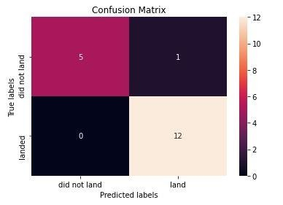
Confusion Matrix
Examining the confusion matrix, we see that Tree can distinguish between the different classes. We see that the major problem is false negatives.

Slide 45
Conclusions
The Tree Classifier Algorithm is the best for Machine Learning for this dataset
High weighted payloads perform better than the lower payloads
The success rates for launches is positively related to time
We can see that KSC LC-39A had the most successful launches from all the sites
Orbit GEO,HEO,SSO,ES-L1 has the best Success Rate

Slide 46


